Slide 1

Binomial heaps
Dr. Anant Ram
Associate Professor
Dept. of CEA, GLA University, Mathura

Slide 2
Binomial trees and binomial heaps
Defining binomial trees and proving some key properties.

Slide 3
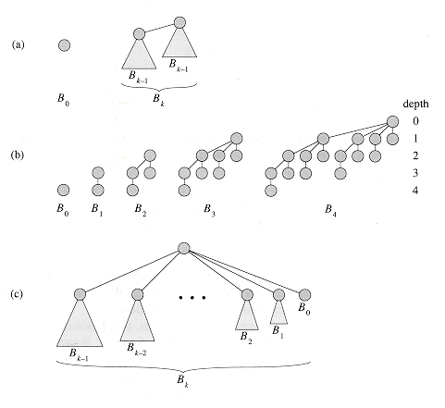
Binomial trees
The binomial tree B_{k} is an ordered tree defined recursively. the binomial tree B₀ consists of a single node. The binomial tree B_{k} consists of two binomial trees B_{k-1} that are linked together: the root of one is the leftmost child of the root of the other.

Slide 4
Properties of Binomial trees
For the binomial tree B_{k},
there are 2^{k} nodes,
2. the height of the tree is k,
3. there are exactly nodes at ^{k}C_{i} depth i for i = 0, 1, . . . , k,
4. the root has degree k, which is greater than that of any other node; moreover if the children of the root are numbered from left to right by k - 1, k - 2, . . . , 0, child i is the root of a subtree B_{i}.

Slide 5
Binomial Heap
A binomial heap H is a set of binomial trees that satisfies the following binomial-heap properties.
1. Each binomial tree in H is heap-ordered: the key of a node is greater than or equal to the key of its parent.
2. There is at most one binomial tree in H whose root has a given degree.

Slide 6
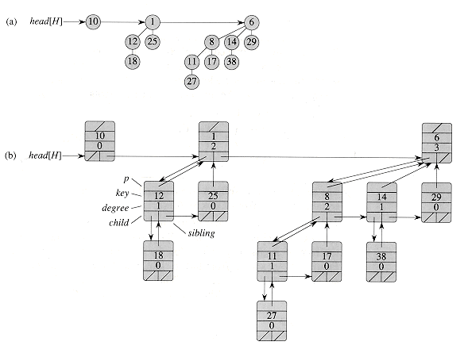
Binomial Heap

Slide 7
Operations on Binomial heaps
BINOMIAL-HEAP-MINIMUM(H)
1. y = NIL
2. x = head[H]
3. min = ∞
4. while x != NIL
5. do if key[x] < min
6. then min = key[x]
7. y = x
8. x = sibling[x]
9. return y
BINOMIAL-LINK(y,z)
1. p[y] = z
2. sibling[y] = child[z]
3. child[z] = y
4. degree[z] = degree[z]+1

Slide 8
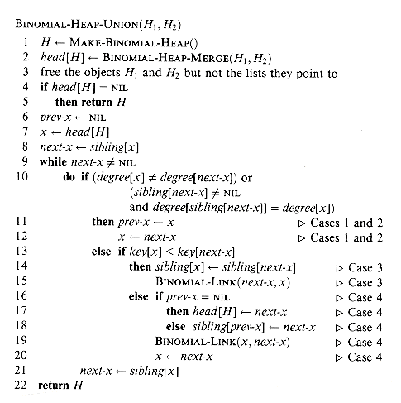
Binomial Heap Union

Slide 9
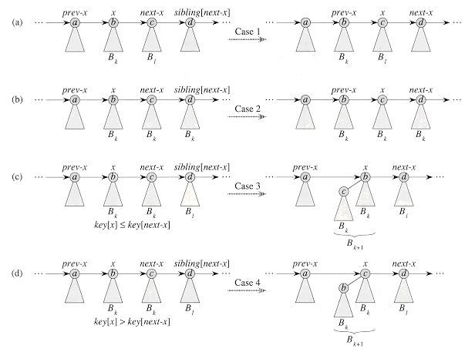

Slide 10
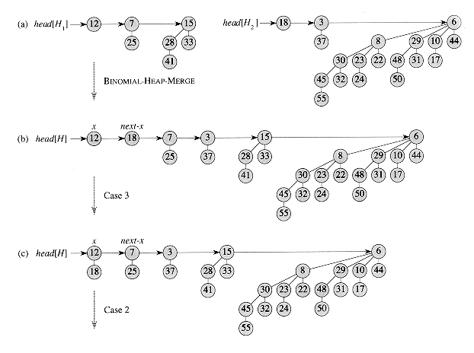

Slide 11
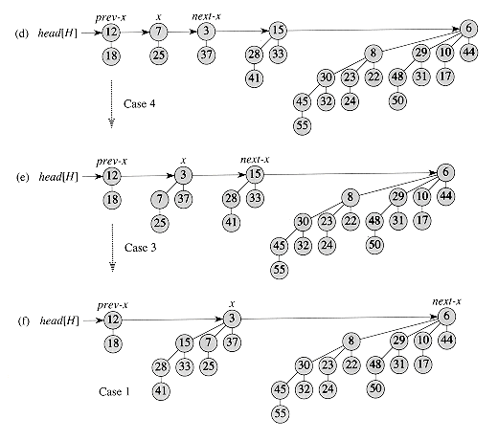

Slide 12
Inserting a node
BINOMIAL-HEAP-INSERT(H,x)
1. H‘= MAKE-BINOMIAL-HEAP()
2. p[x]= NIL
3. child[x]= NIL
4. sibling[x]= NIL
5. degree[x]= 0
6. head[H']= x
7. H= BINOMIAL-HEAP-UNION(H,H')

Slide 13
Extracting the node with minimum key
BINOMIAL-HEAP-EXTRACT-MIN(H)
1 find the root x with the minimum key in the root list of H,
and remove x from the root list of H
2 H‘= MAKE-BINOMIAL-HEAP()
3 Reverse the order of the linked list of x's children,
and set head[H'] to point to the head of the resulting list.
4 H= BINOMIAL-HEAP-UNION(H,H')
5 return x

Slide 14
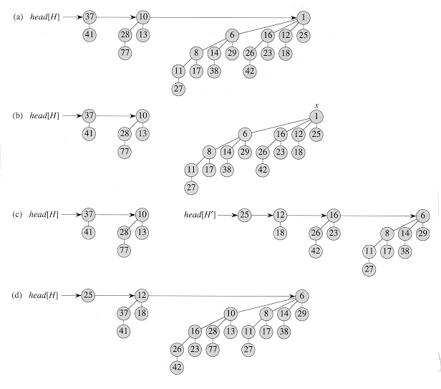
Extracting the node with minimum key

Slide 15
Decreasing a key
BINOMIAL-HEAP-DECREASE-KEY (H,x,k)
1 if k > key[x]
2 then error "new key is greater than current key"
3 key[x] = k
4 y =x
5 z = p[y]
6 while z!= NIL and key[y] < key[z]
7 do exchange (key[y], key[z])
8 y= z
9 z= p[y]

Slide 16
Binomial Heap

Slide 17
Binomial Heap

